Slide 1

Graduate Technology Project (CPSC 6440)
By :-
Chirayu Sharma (C77139645)
Shivam Panwar (C70182808)

Slide 2

Predicting heart disease using AWS SageMaker
AWS Service used :
-AWS S3
-AWS SageMaker
-AWS Lambda
-AWS API Gateway
-AWS CloudFormation
-AWS SNS

Slide 3

AWS SageMaker
Fully managed.
Provides Jupyter notebooks
Build, train and deploy Machine Learning models quickly.
High performance prediction

Slide 4
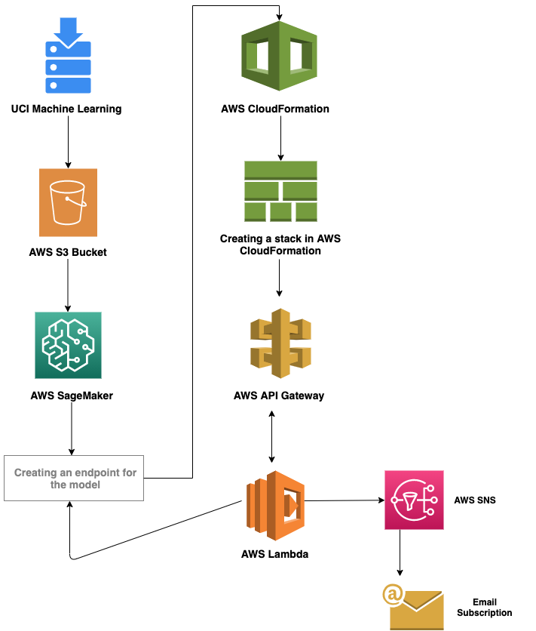
Flowchart of the process

Slide 5
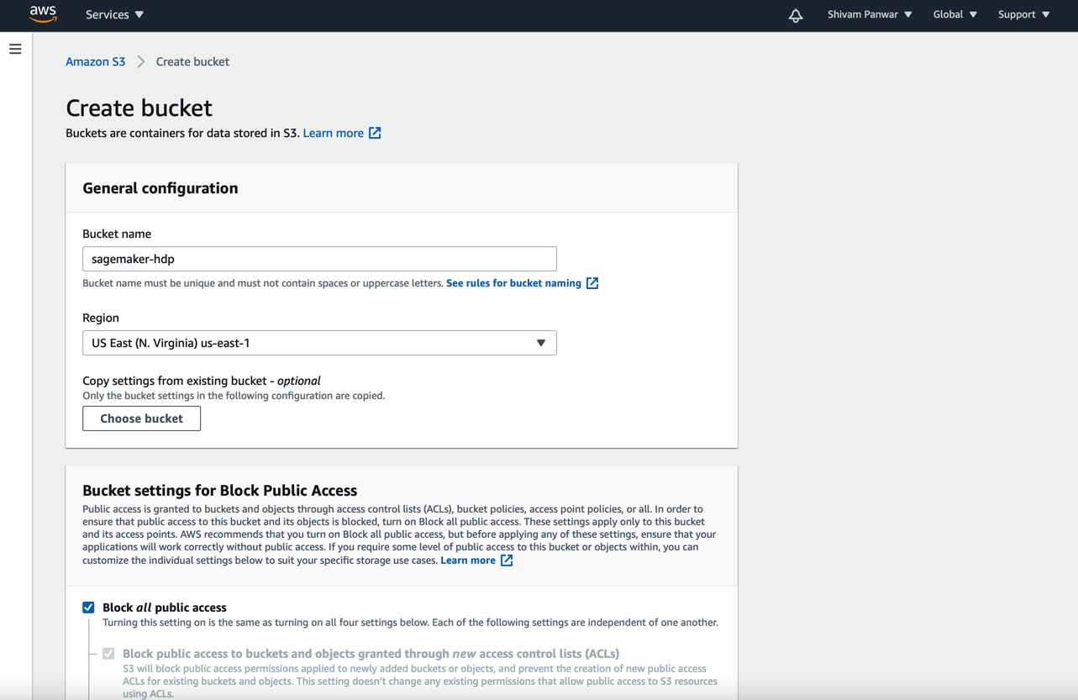
-In AWS Management console, create a S3 bucket

Slide 6
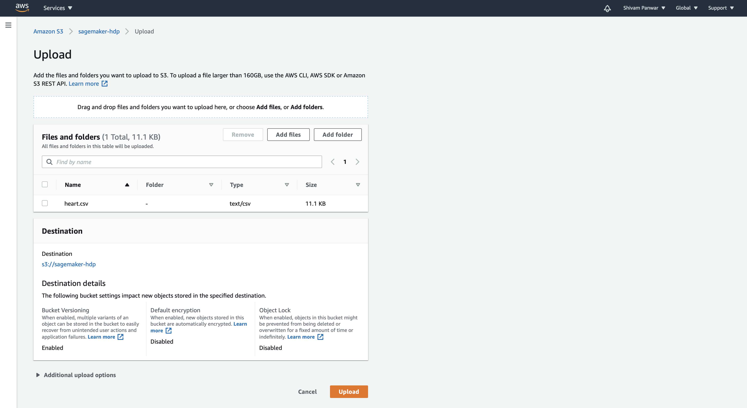
- After creating a S3 bucket, upload the “.csv” file in it.

Slide 7
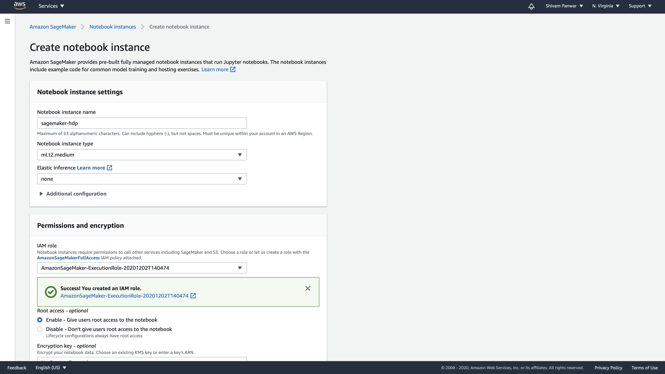
-In AWS SageMaker, create a notebook instance (conda Python3)

Slide 8
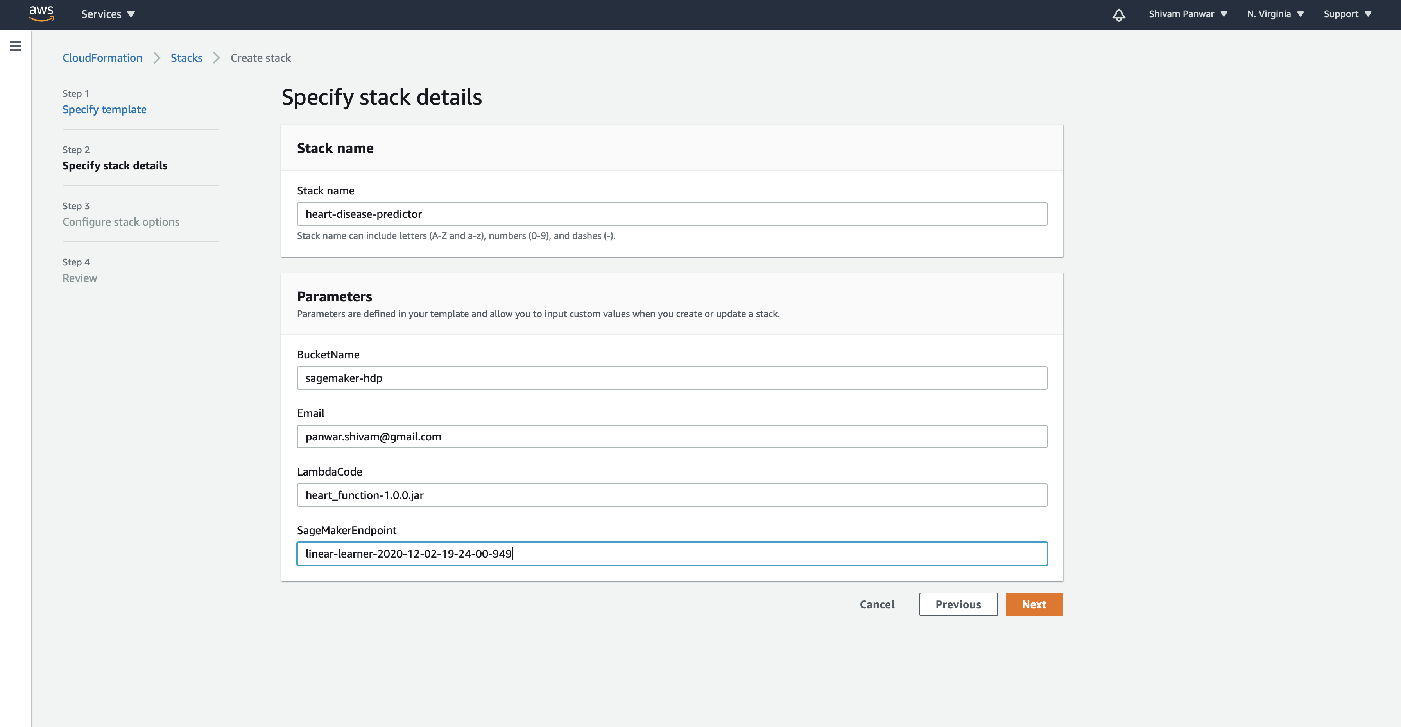
-Create a stack under AWS CloudFormation

Slide 9
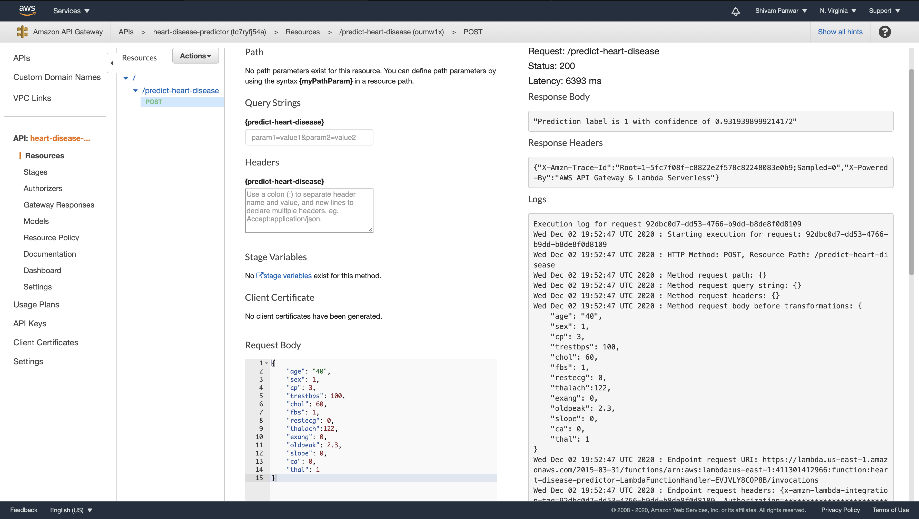
-Using API Gateway to invoke API in real-time and getting the response as “1”

Slide 10
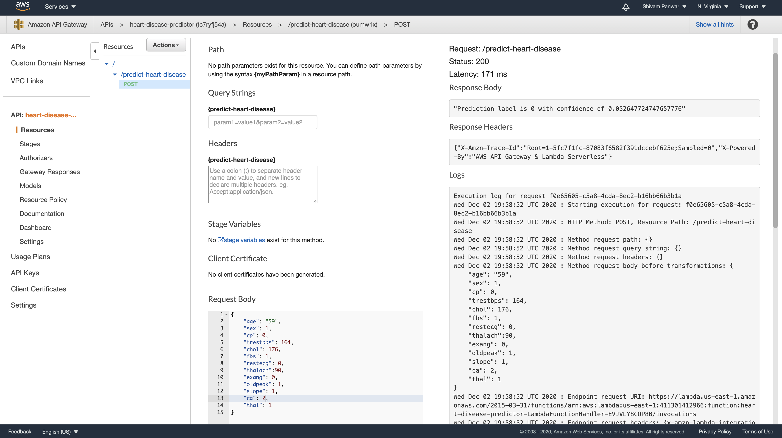
-Using API Gateway to invoke API in real-time and getting the response as “0”

Slide 11
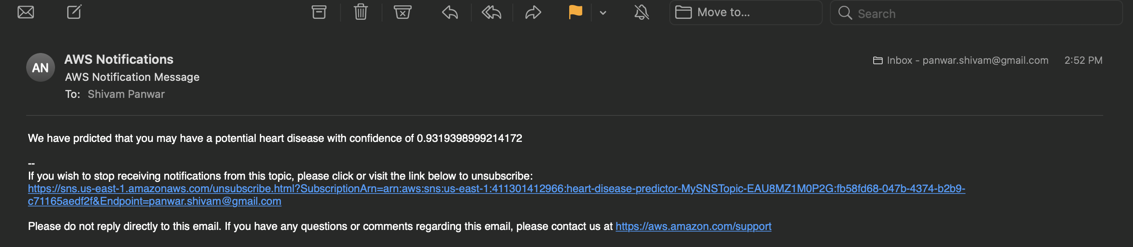
-Once you have confirmed subscription, you will get an email address through AWS SNS.

Slide 12
THANK YOU

